Slide 1
Capstone Project
Pregnancy Guide to Traditional Chinese Medicine Using Near Field Communication Technologies
Chee Sze Yan // 1141128242
Hor Sui Lyn // 1161300122
Liyana Safinaz // 1161302653

Slide 2

O V E R V I E W
Problem Statement
Objective
Related Works
System Design
Research Schedule
System Implementation

Slide 3


Problem Statement
Misconception
Same effect when taking TCM during pregnancy
From myths/elderly

Slide 4
Objectives
Provide information of TCM on pregnancy
Effects of TCM on pregnancy

Slide 5

RELATED WORKS

Slide 6
HearMe: a Touch-to-Speech UI for Medicine Identification (2011)
RELATED WORKS (1)
What
-NFC tags on medicine, store text info
- Text-to Speech synthesizer play audio
How
TCM info store in drugs, identify precaution
Information is played via speech
Harjumaa, M., Isomursu, M., Muuraiskangas, S., & Konttila, A. (2011, May). HearMe: A touch-to-speech UI for medicine identification. In Pervasive Computing Technologies for Healthcare (PervasiveHealth), 2011 5th International Conference on (pp. 85-92). IEEE.

Slide 7
Limitations
Unclear pronunciation of foreign words, such as medicine name
Difficulty in understanding
May mistaken a medicine for another

Slide 8
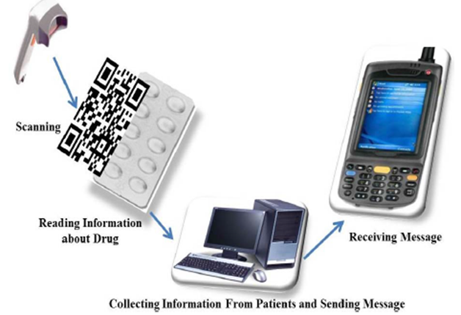
Ascertain of Barcode Technology in Fashion Remedy Attentiveness (2014)
RELATED WORKS (2)
What
-Barcode in drugs packaging -Information sent via SMS
How
Substitute with TCM
Scanning Barcode of TCM they are advised to use
TCM side effects details
Saravanan, C. B., & Sarasu, P. Ascertain of Barcode technology in fashion remedy attentiveness. In 2014 International Conference on Science Engineering and Management Research (ICSEMR).

Slide 9
Limitations
Lighting condition affect scanning
Scan more than one time
Inefficient / Frustration

Slide 10
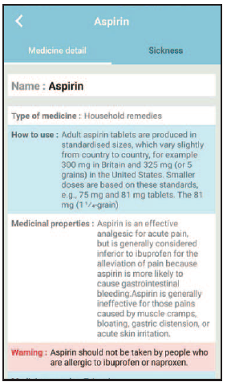
Mobile Search Engine for Medicine Information on Smartphone (2017)
RELATED WORKS (3)
What
- Effects, warning
How
- Substitute with TCM information
- Focus on possible effects on pregnancy
Ketmaneechairat, H., Jongsiriworachot, K., & Thangtoon, C. (2017, September). “Mobile search engine for medicine information on smartphone”. In Digital Information Management (ICDIM), 2017 Twelfth International Conference on (pp. 197-201). IEEE.

Slide 11
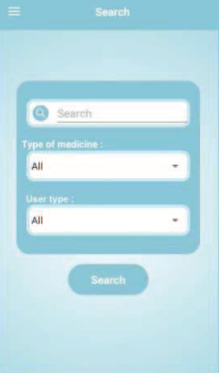
Limitations
Indirect access to information
Misspell keyword
Search function
No result

Slide 12
SYSTEM DESIGN

Slide 13
SYSTEM ARCHITECTURE

Slide 14











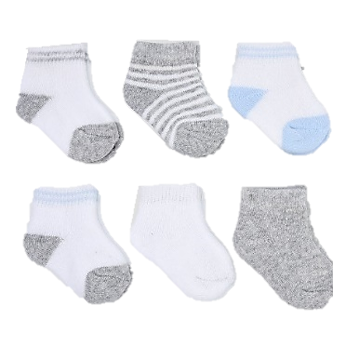


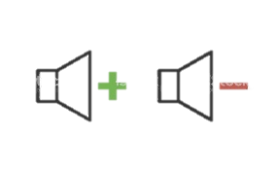


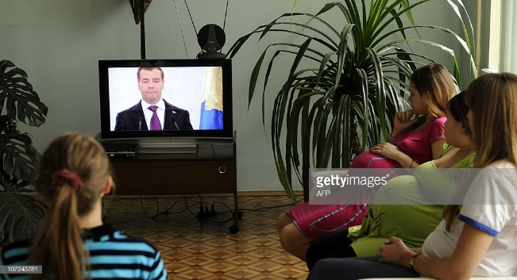
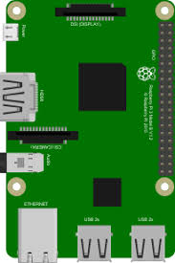

Tap NFC tag on smartphone to play video
Download smartphone app and browse through application
Pregnant women at maternal clinic
-Uses
-Precautions on pregnancy
Connect to RPI through BLE to watch video on display
NFC tags to play video, control video playback and control volume level
+
Information on TCM including precaution for pregnant women
Traditional Chinese Medicine interactive booth
Display a short information video
Tap NFC tag on NFC reader connected to RPI to watch video

Slide 15
Limitations Overcame
Unclear pronunciation of medicine names
Provide texts form of medicine names
Lighting condition affect scanning
Barcodes replaced with NFC tags
Indirect access of information
Instant access using NFC technology

Slide 16
FLOWCHARTS

Slide 17

FLOWCHART FOR ANDROID

Slide 18
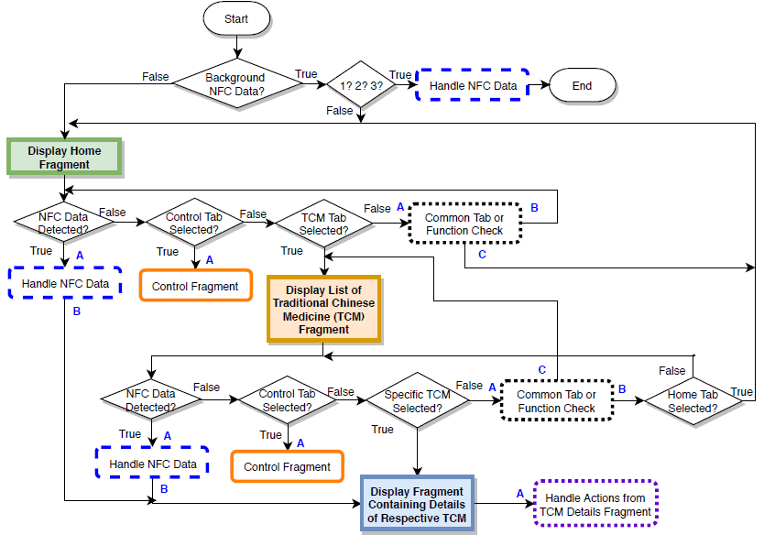

Slide 19
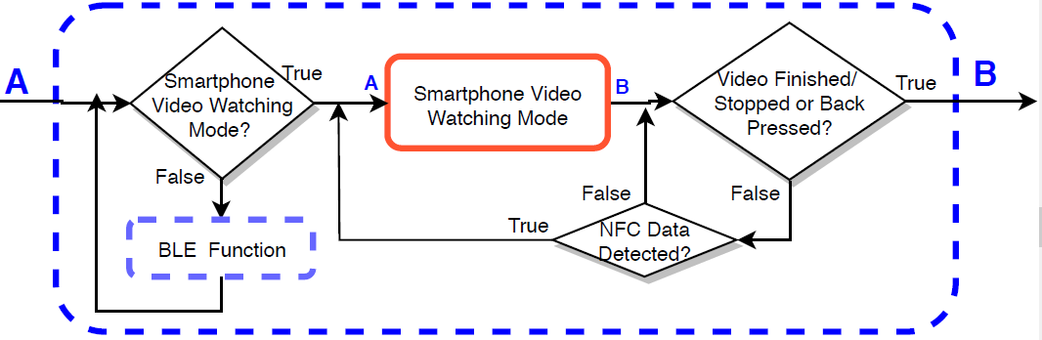
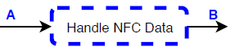
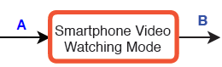
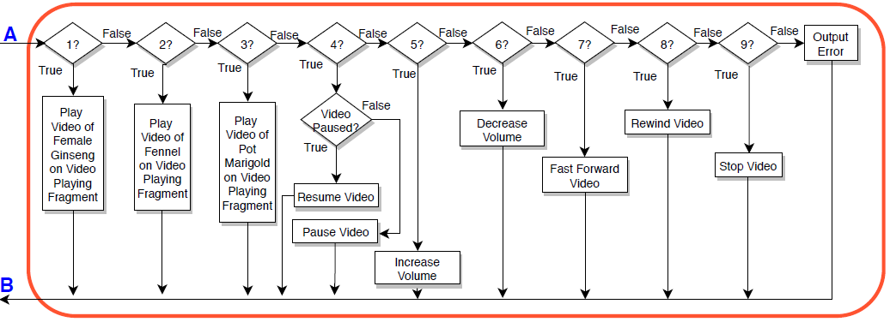

Slide 20
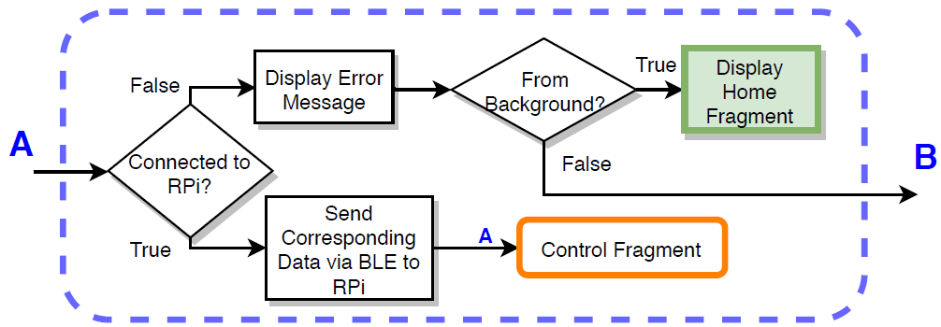
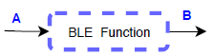
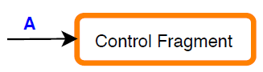
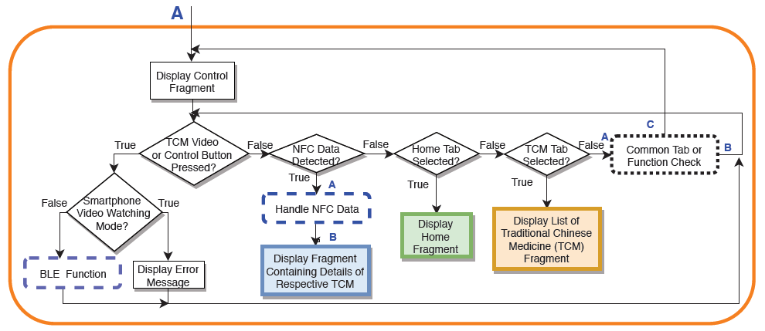

Slide 21
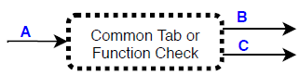
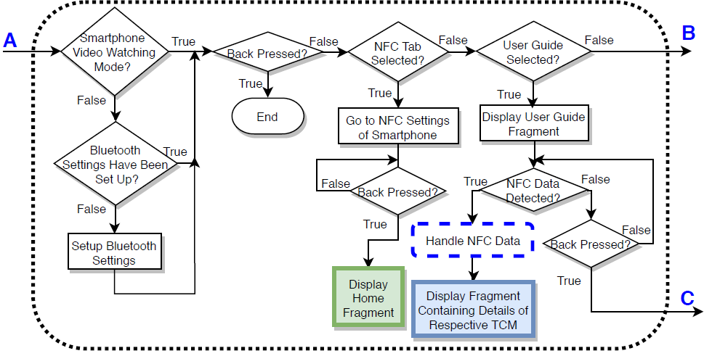

Slide 22
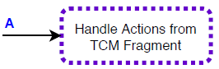
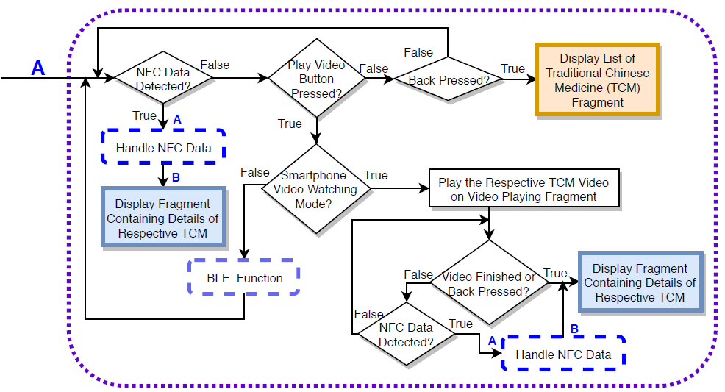

Slide 23

FLOWCHART FOR RASPBERRY PI

Slide 24
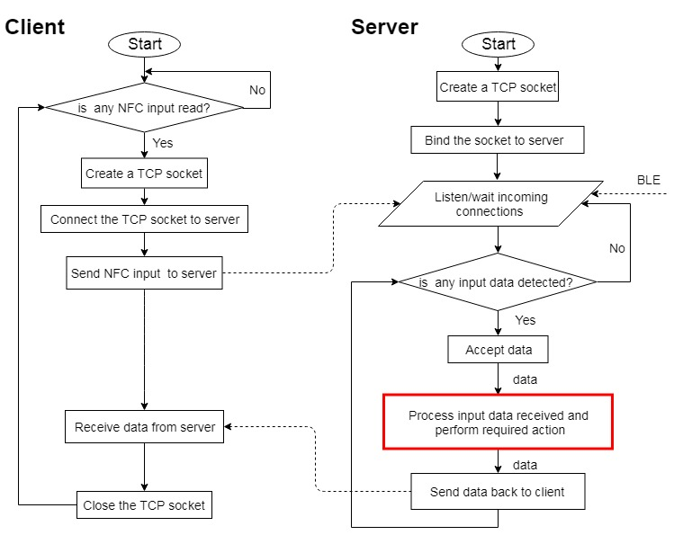

Slide 25
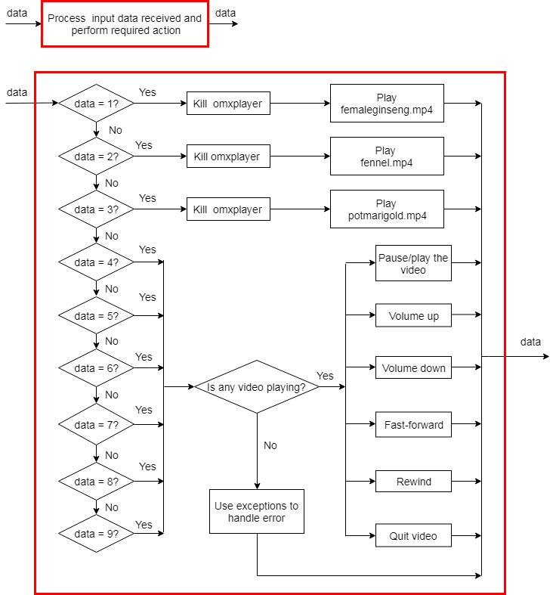

Slide 26
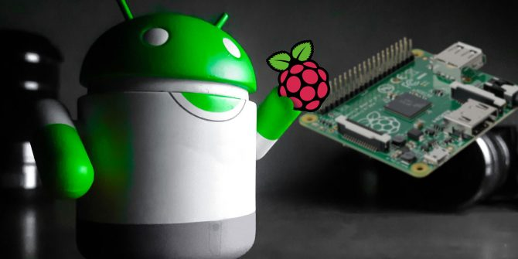
FLOWCHART FOR INTEGRATOR

Slide 27
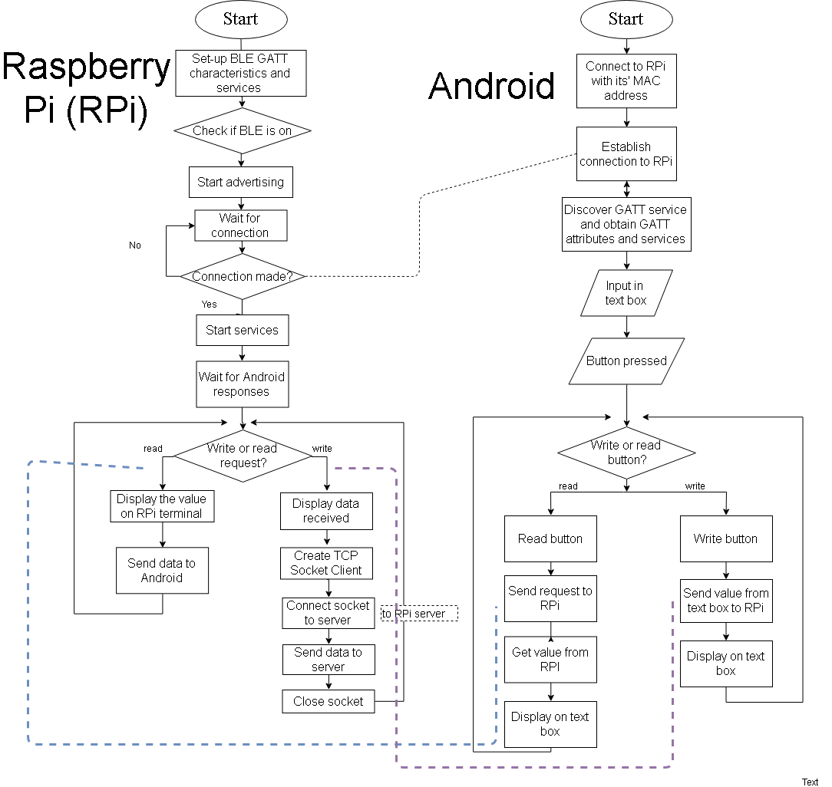

Slide 28
RESEARCH SCHEDULE

Slide 29
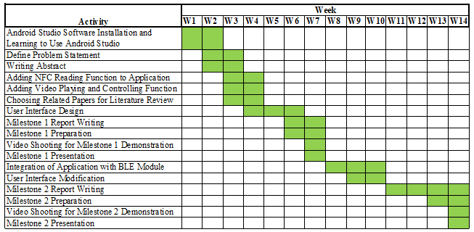
Gantt Chart for Android

Slide 30
Gantt Chart for Raspberry Pi

Slide 31
Gantt Chart for Integrator

Slide 32
SYSTEM IMPLEMENTATION

Slide 33
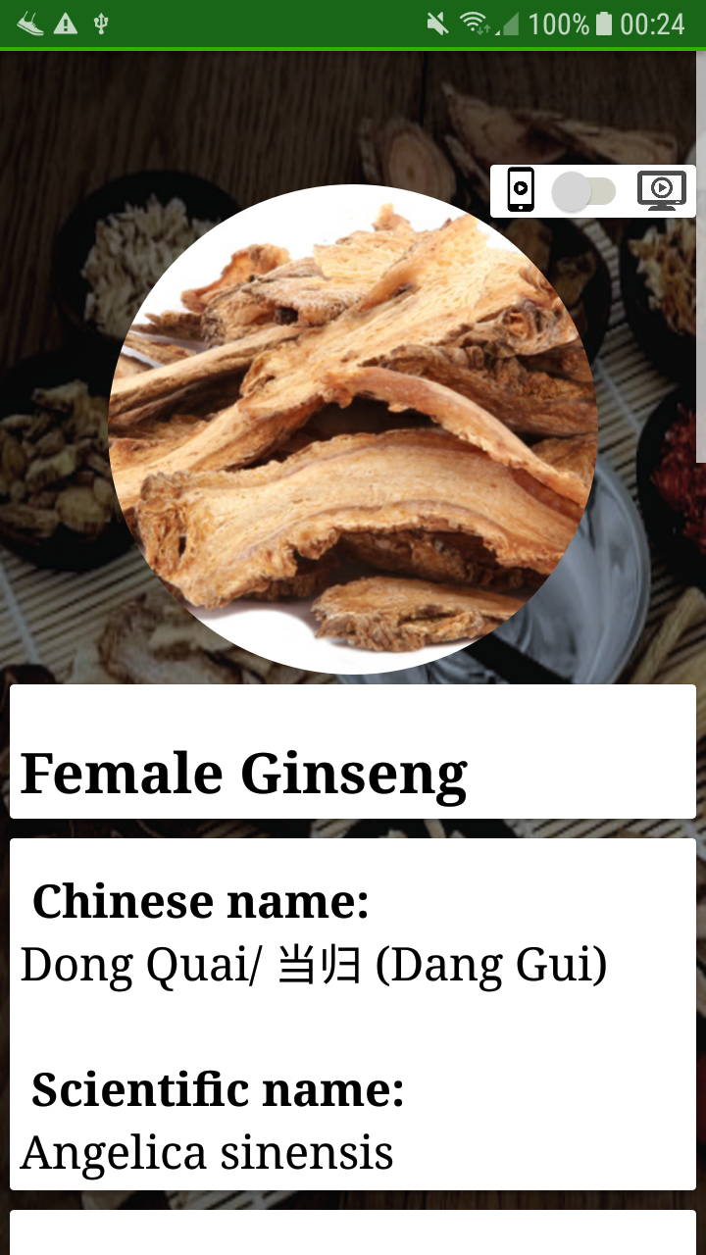
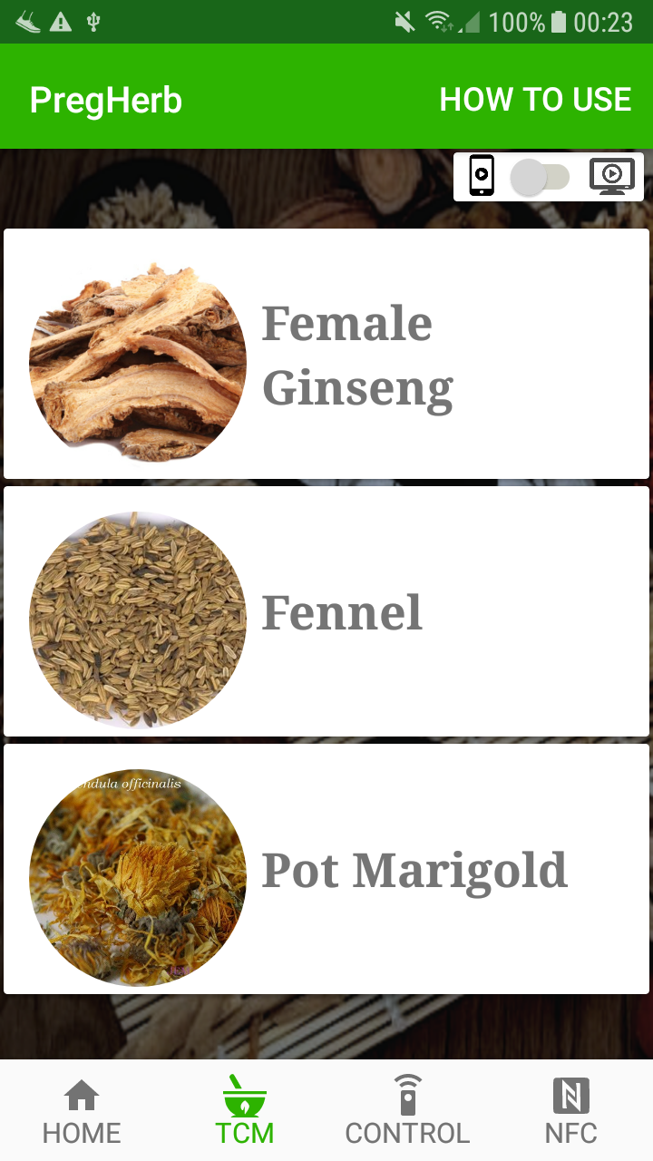
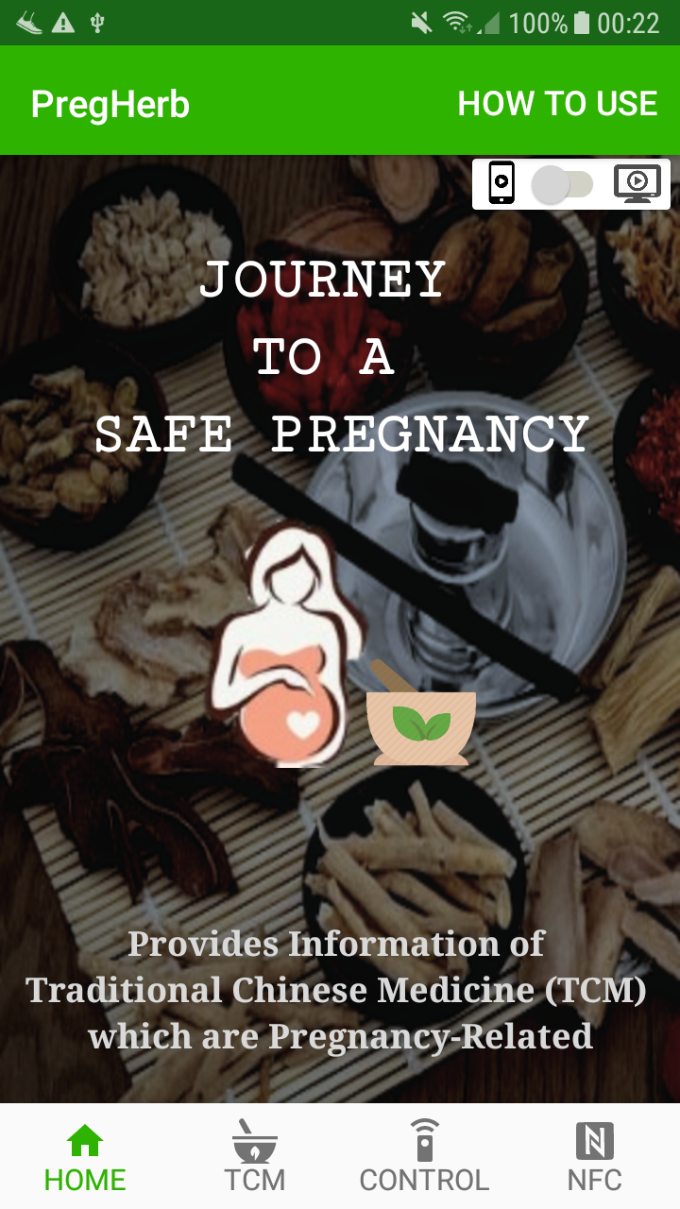
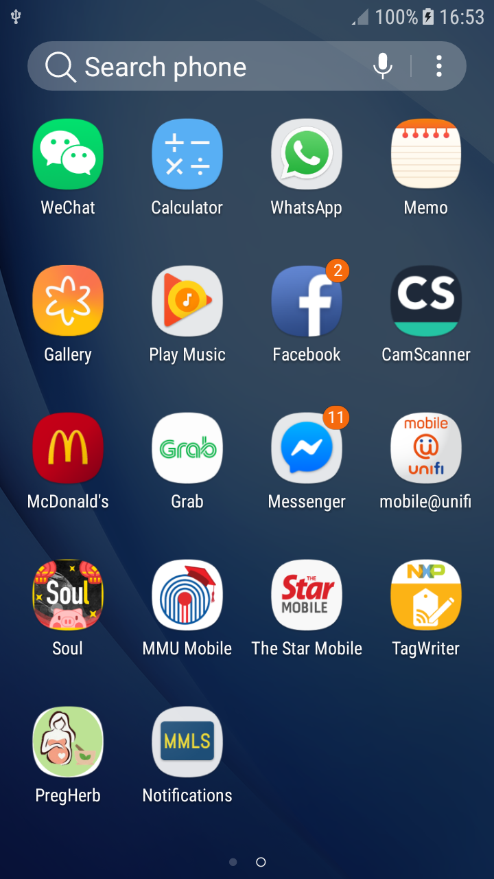
Working System For Android
Selected TCM
List of TCM
Home Page

Slide 34
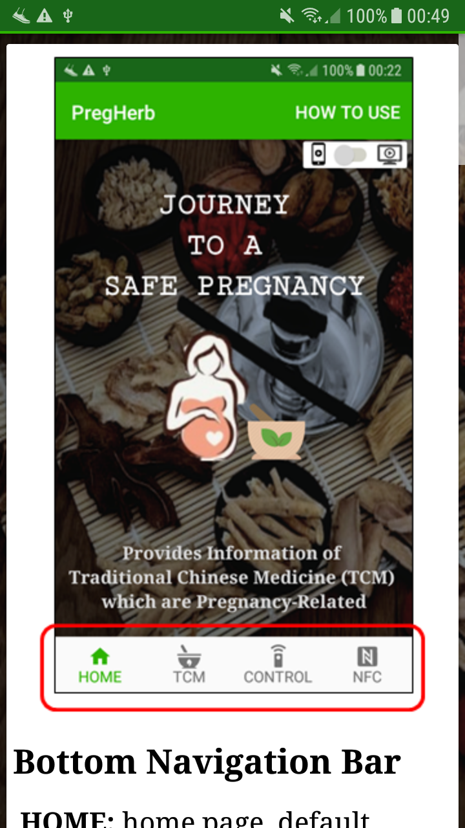
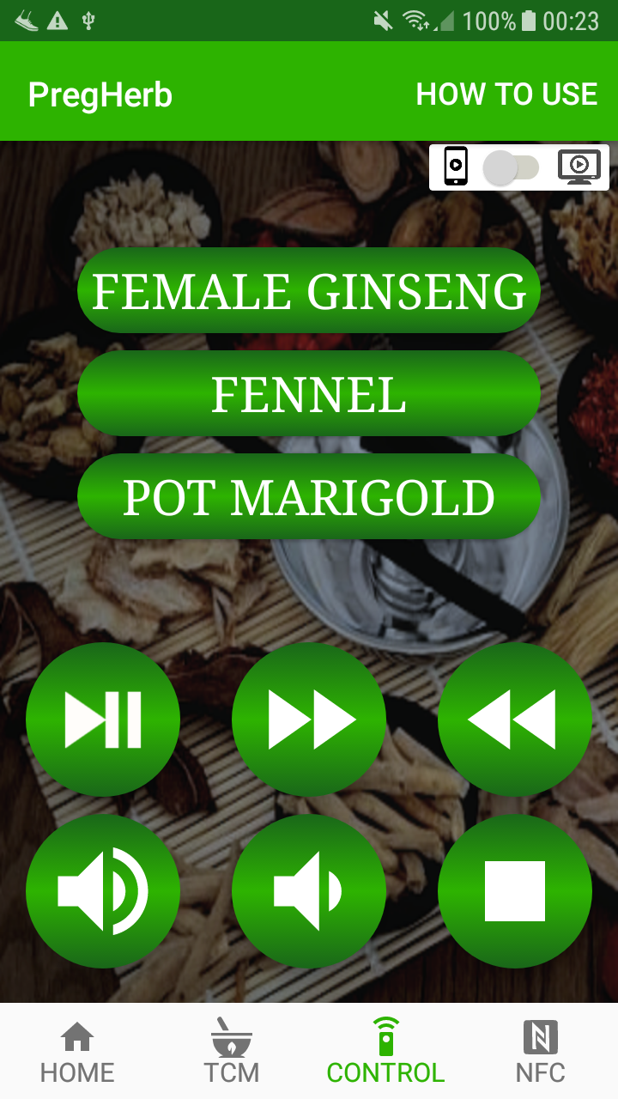
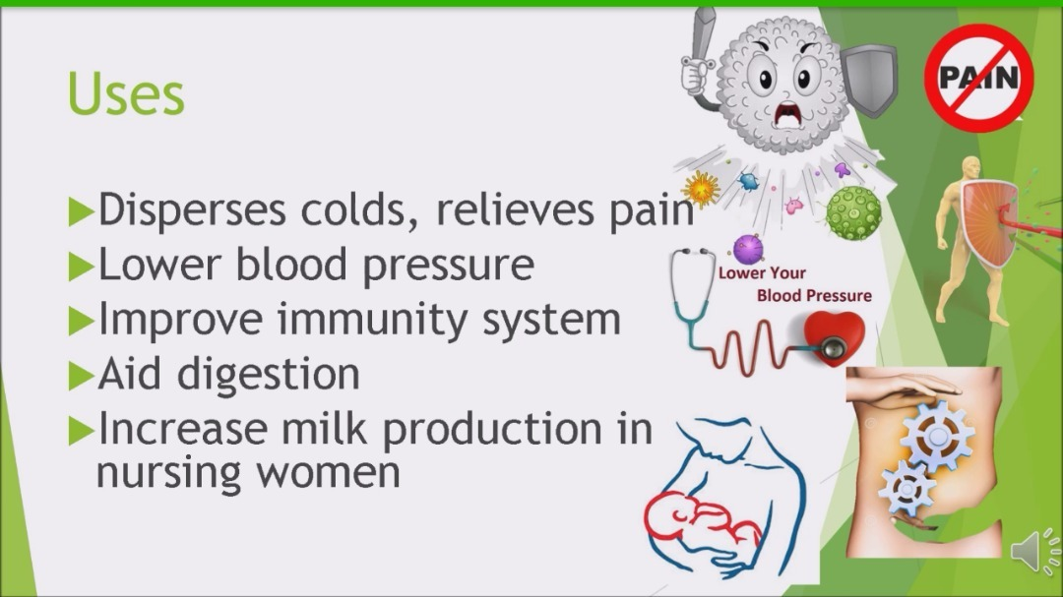
Working System For Android
Video Playing
User Guide
Control Page

Slide 35
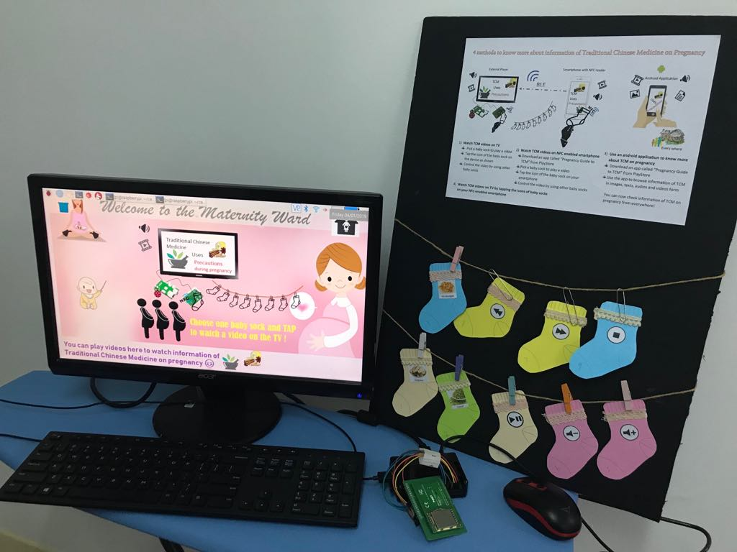
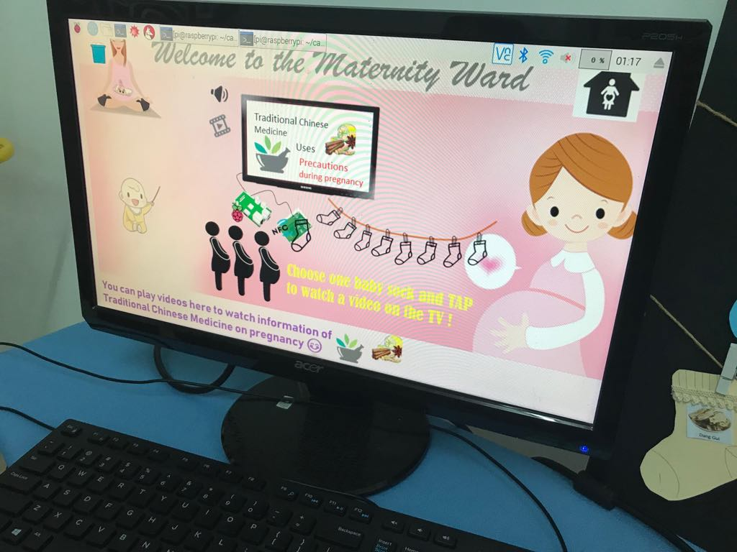
Working System For Raspberry Pi
Complete system of a Raspberry Pi
Background photo telling instructions on how to use the Raspberry Pi

Slide 36
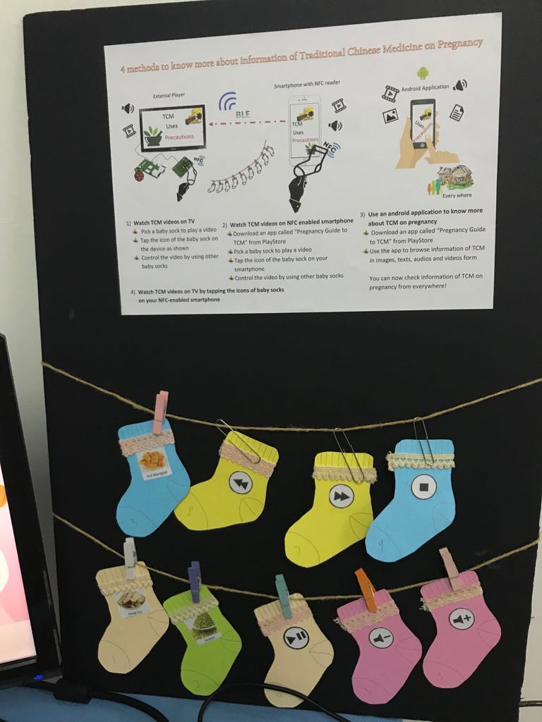
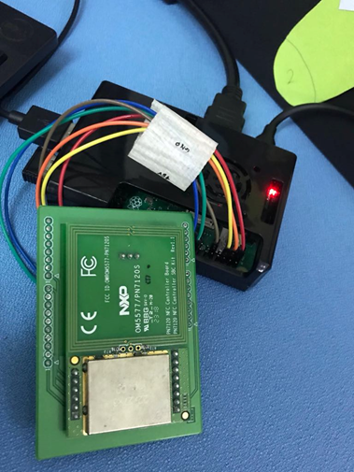
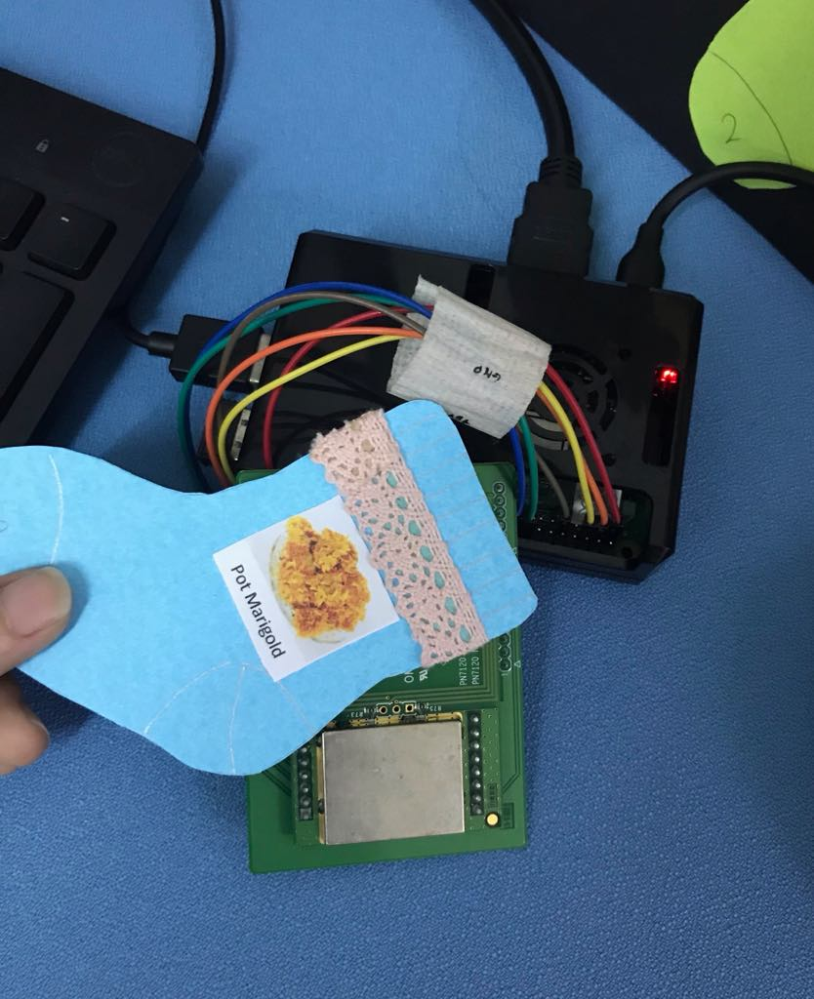
Working System For Raspberry Pi
NFC tags tapped
NFC reader connected to Raspberry Pi
Interactive booth showing baby socks embedded with NFC tags

Slide 37
T H A N K Y O U

